Slide 1
Sprint 2
Alzheimer's Facial Recognition
Gabriel Thomas, Irald kollcinaku, Robert Turczyn, Tyler Schauss, Jacob Carpenter, Zilin Li

Slide 2
Vision Statement
Our vision is to build a bridge between humans and machines through software technology. Through a skilled team of developers, we acknowledge the need for a change in medical conditions that affect not only the patients but also their loved ones. Our team strives to build a superior app to empower Alzheimer's patients recognize people in their daily routine.
Incorporating facial recognition, tracking and reminders is our main focus in constructing this helpful app.

Slide 3
Challenges
Time management
Becoming familiar with PWA apps
Differences with applications between mac and windows
Understanding our desired tech stack
Effectively organizing workload
Future
Ensuring long-term battery life to the device
Facial recognition accuracy
Lighting conditions and age affecting recognition

Slide 4
Mitigation Plan
Minimum one scheduled face-to-face meeting, with multiple online meetings throughout the week.
Keeping open options on our facial detection and recognition software. May pursue using an android SDK provided by Arcsoft if we cannot implement OpenCV
Keep screen dimming until client start to use this application.
Continuing to update the risk mitigation plan in the following development life cycle.

Slide 5
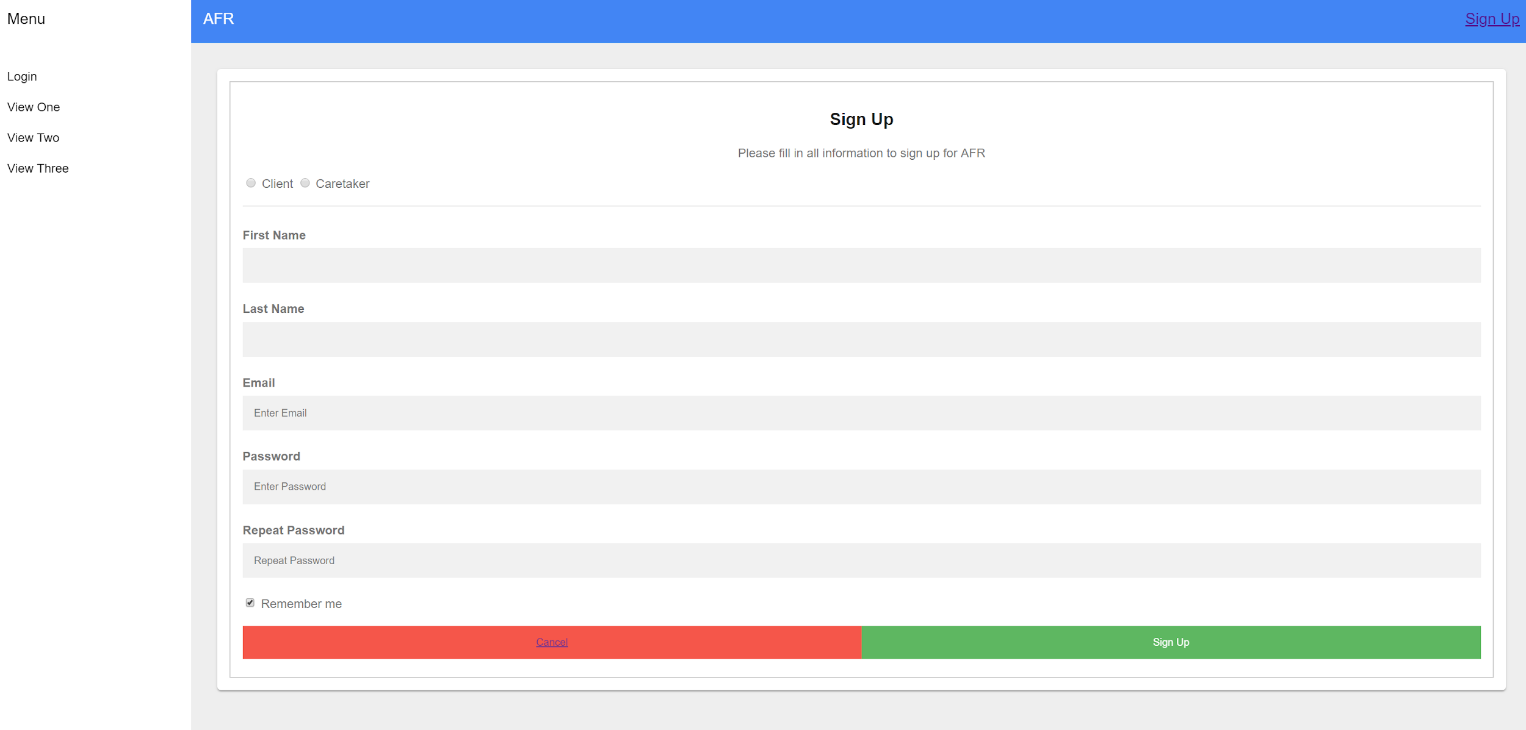
User Account Creation

Slide 6
Role Management

Slide 7
Profile Update

Slide 8
Email verification? Locking/unlocking accounts?

Slide 9
Upcoming Objectives
Setup a Firebase hosted server
Will host NoSQL Database
Will hold data for client’s contacts
Will hold images of client’s contacts
Use the device camera to achieve facial recognition
Utilize text to speech to upon facial recognition
Will tell client the recognized contact’s information
Allow clients to upload images and data of contacts
Allow caretakers to upload images and informations that is connected to a client’s account
Use PWA to create a web portal as well as Android and iOS apps
Possible implement a location setting that can show the location of a client to a caretaker.

